Slide 1
Digital Portfolio
STUDENT NAME: Ramya S
REGISTER NO AND NMID: 2422K0255&asbru 2422K0255
DEPARTMENT: B.sc (cs)
COLLEGE: Sri vasavi college self finance wings Barathiar university

Slide 2
PROJECT TITLE
My Bio Data

Slide 3


AGENDA
Problem Statement
Project Overview
End Users
Tools and Technologies
Portfolio design and Layout
Features and Functionality
Results and Screenshots
Conclusion
Github Link
3/21/2024 Annual Review

Slide 4
PROBLEM STATEMENT
"Nowadays, students and professionals often face difficulties in presenting their bio data in a clear and attractive way. Traditional paper bio data or resumes are limited, easily misplaced, and do not highlight skills interactively. A bio data website solves this problem by providing a digital platform to showcase personal information, education, skills, and achievements in an organized and accessible manner.

Slide 5

PROJECT OVERVIEW
Creating Web page in digital portfolio to bio data.Using the language HTML CSS JavaScript .

Slide 6

WHO ARE THE END USERS?
All the user and humans are the end user.

Slide 7

TOOLS AND TECHNIQUES
Digital portfolio
visual basic stdio
Code pee
HTML
CSS
Javascript

Slide 8
POTFOLIO DESIGN AND LAYOUT
8

Slide 9
FEATURES AND FUNCTIONALITY
Features of Biodata Website
User-friendly Interface – Simple and clean design for easy navigation.
Personal Information Section – Displays name, photo, contact details, etc.Features of Biodata Website
Facilities of Biodata Website
Provides a digital platform for presenting biodata.
Accessible anytime, anywhere via the internet.

Slide 10
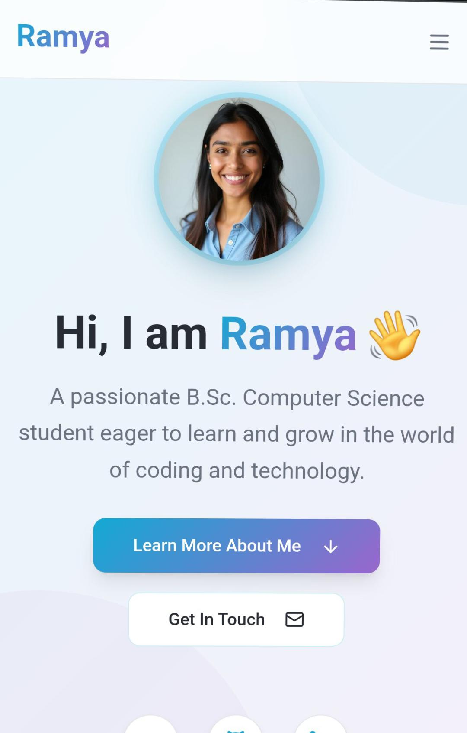

RESULTS AND SCREENSHOTS
3/21/2024 Annual Review
10

Slide 11
CONCLUSION
In conclusion, the bio data website provides a simple and effective platform to present personal, educational, and professional details in a well-organized manner. It eliminates the limitations of traditional paper resumes and makes information easily accessible anywhere, anytime.
11

